Slide 1
Process Management
Module 3
ITSC205
Operating Systems Internals

Slide 2
Module Objectives
Describe process states and state transitions.
Explain operations performed on processes.
Analyze process creation and termination mechanisms.
Describe how a process can be divided into threads.
Explain process programming and system calls
Differentiate inter-process communication techniques

Slide 3
Process Management Activities
The operating system is responsible for the following activities in connection with process management:
Creating and deleting both user and system processes
Assign resources such as CPU time , memory space , files to processes to complete their jobs
Suspending and resuming processes
Providing mechanisms for process synchronization
Providing mechanisms for process communication (IPC)
Providing mechanisms for deadlock handling

Slide 4
Process Concepts
Process – a program in execution; process execution must progress in sequential fashion. A process is a memory space and data structure
User processes vs System processes
When a process is created, the process will request resources to complete its task such as:
CPU time and Registers
Memory space (Stack , Heap)
Environment (variables)
Signals
Files (Handles in Windows or fd (in Linux))

Slide 5
Process and Threads
Unix runs a program by loading the executable code into a process. Each running program runs in its own process
Each process has its own data space, file descriptors, unique PID number, owner, size and other properties
When a process runs in CPU, it monopolizes the resources and other processes have to wait till the current process in running state releases the resources.
Threads instead are instances that can run simultaneously within a process and they are faster than processes because they share resources such as: code, data, files and PID

Slide 6
Single and Multithreaded Processes
code
data
files
code
data
files
registers
stack
registers
registers
registers
stack
stack
stack
Thread
Thread
Thread
Thread
single-threaded
multi-threaded

Slide 7
Process and Memory Address Space
Process Address space is divided into:
The program code, also called text section
Current activity including program counter, processor registers
Stack containing temporary data
Function parameters, return addresses, local variables
Data section containing initialized and uninitialize variables - global variables
Heap containing memory dynamically allocated during run time
One program can be several processes
Consider multiple users executing the same program
One process can have several threads

Slide 8
Process Memory Address Space
To display memory sections sizes and total used per running process use the following command:
size executable
size a.out

Slide 9
Memory Address Space
/proc/kallsyms file contains symbols to link and load modules with the respective memory location such as:
T or t Symbol is in Text Section
B or b Symbol is in uninitialized section (BSS)
D or d Symbol is in initialized section
R or r Symbol is in read only data section
man nm - will display the symbol name and type

Slide 10
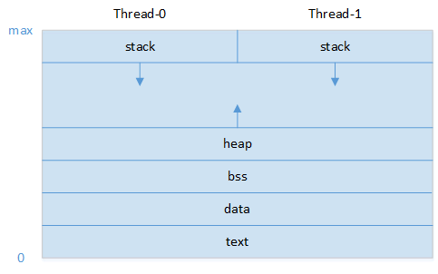
Threads in Memory

Slide 11
Process Control Block (PCB)
When a process is created, the OS creates a structure called task_struct that contains information associated with the process. This structure is known as Process Control Block (PCB)
Processes PCBs are implemented as a doubly linked list. Each PCB has a pointer to the previous PCB and a pointer to the next PCB
task_struct fields are defined in sched.h
/usr/src/linux-headers-5.0.0.37/include/linux/sched.h
https://github.com/torvalds/linux/blob/master/include/linux/sched.h

Slide 12
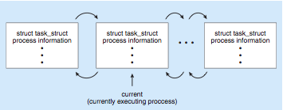
Process Representation in Linux
Represented by the C structure task_struct pid_t pid; /* process identifier */ long state; /* state of the process */ unsigned int time slice /* scheduling information */ struct task struct *parent; /* this process’s parent */ struct list head children; /* this process’s children */ struct files struct *files; /* list of open files */ struct mm struct *mm; /* address space of this process */

Slide 13
PCB
The PCB contains:
Process state – running, waiting, etc
Program counter – location of instruction to next execute
CPU registers – contents of all process-centric registers
CPU scheduling information- priorities, scheduling queue pointers
Memory-management information – memory allocated to the process
Accounting information – CPU used, clock time elapsed since start, time limits
List of open files (handles)
I/O status information – I/O devices allocated to process, list of open files
Pointer to Threads Control Block (TCB)

Slide 14
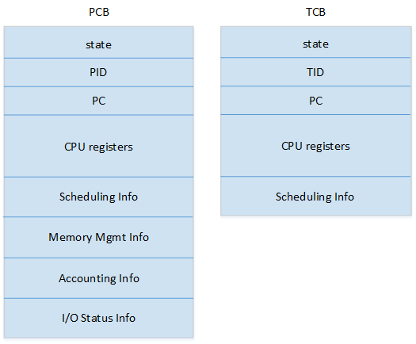
Thread Control Block (TCB)

Slide 15
PCB - /PROC
In Unix systems the PCB can be accessed via /PROC pseudo file system
During the initialization phase of Linux, the star_kernel( ) creates kernel thread, named process 1 ( init or systemd process)
To allow an efficient search through processes of a given type , the kernel creates several lists of processes
Each list consists of pointers to process descriptors (Process Control Block)

Slide 16
Linux /PROC Pseudo File System
Proc is a pseudo file system is an interface to kernel data structure. Linux: man proc
Every time a process is created, Linux OS will create the data structure for the process within /proc directory. Every number in the PROC directory represents a PID. The directory contains the process data structure (information about the process ) . e.g the directory 1 contains the data structure of init or systemd process with PID 1
The maximum number of process PID can be found in the file: /proc/sys/kernel/pid_max

Slide 17
Context Switch
When CPU switches to another process, the system must save the state of the old process and load the saved state for the new process via a context switch
Context of a process represented in the PCB
Context-switch time is overhead; CPU idle time
The more complex the OS and the PCB -> longer the context switch
Time dependent on hardware support
Some hardware provides multiple sets of registers per CPU -> multiple contexts loaded at once
cat /proc/pid/status to display context switches per PID

Slide 18
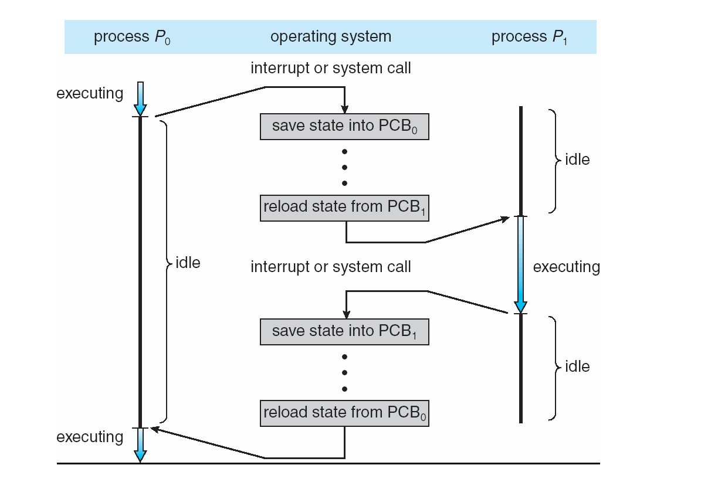
Context Switch

Slide 19
Process State
As a process executes, it changes its state
new: The process is being created
running: Instructions are being executed in CPU
waiting: The process is waiting for some event to occur such as I/O
ready: The process is waiting in memory to be assigned to a processor
terminated: The process has finished execution

Slide 20
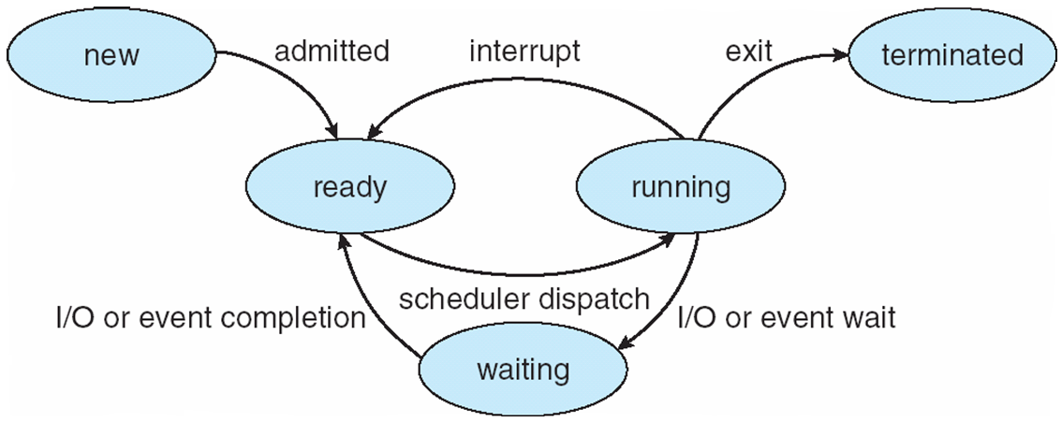
Diagram of Process State

Slide 21
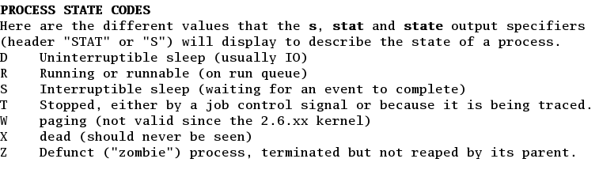
Linux Process’ States
Notes:
“Screen Capture of Linux man ps command is released under the GNU General Public License (GPL). See the terms at http://www.gnu.org/licenses/license-list.html”

Slide 22
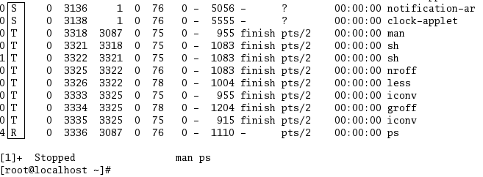
Linux Process’ Attributes
In Linux processes can be traced using ps or top commands.
Notes:
“Screen Capture of Linux PS command is released under the GNU General Public License (GPL). See the terms at http://www.gnu.org/licenses/license-list.html”

Slide 23
Signals
Signals are asynchronous messages send to processes/thread to notify it of an event.
There are different ways to send signals to a process:
1. kill command
2. Use shortcuts combining keyboards keys
3. At the programming level use the signal name such as SIGTERM, SIGKILL, SIGSTOP
Keyboard kill Signal Name
Ctrl-c kill -2 SIGINT
Ctrl-z kill -19 SIGSTOP
Ctrl-\ kill -3 SIGQUIT
Ctrl-u kill -9 SIGKILL

Slide 24
Kill Command
A process can be terminated by sending interrupt or termination signals
kill command is used to send signals to a process
Kill Syntax:
kill code PID
The code of each signal can be found with
kill –l command

Slide 25
Signals
SIGTERM (kill -15) –Default terminates a process, the process is allowed to release resources in a proper way. This allows the process to perform nice termination, releasing resources and saving state if appropriate
SIGSTOP: ( kill -19) stop signal. It suspends processes and produces a core dump file (disk file containing an image of the process’ memory. This image can be used by a debugger to verify process state). Processes that received SIGSTOP signal become jobs and can be resumed.
SIGKILL ( kill -9) process terminated immediately without closing resources properly. Files opened by the process can be damaged while terminating the process, as the file buffers are not flushed to the disk.
SIGSTOP and SIGKILL cannot be blocked or ignored
For signals overview use Linux: man 7 signals or man kill or
info signal

Slide 26
Zombie and Orphan Processes
A process that has died but still has an uncollected exit(0-255) value.
Linux ps command list these processes as defunct
A process holding system resources.
If a parent process is terminated for any reason before its child process completes its job, the child process becomes a zombie because it will hold system resources and deteriorates system performance.
If the child process is adopted by INIT (PID 1) process then the child process becomes and Orphan

Slide 27
Process Creation
Parent process create child processes, which, in turn create other processes, forming a tree of processes
Process identified and managed via a process identifier (pid).
Resource sharing options
Parent and children share all resources
Children share subset of parent’s resources
Parent and child share no resources
Execution options
Parent and children execute concurrently
Parent waits until child terminates

Slide 28
Process Creation
Why would we want a copy of parent’s address space?
Inherit information!
Environment variables
Scheduling context (registers, priority)
File system context (root and default directories)
Virtual memory context
Permissions
Call stack
Signal handler table
etc.

Slide 29
A Tree of Processes in Linux

Slide 30
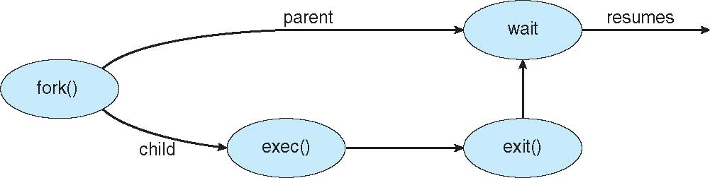
Process Creation (Cont.)
Address space
Child duplicate of parent
Child has a program loaded into it
UNIX examples – Processes System Calls
fork() system call creates new process
exec() system call used after a fork() to replace the process’ memory space with a new program

Slide 31
Linux Process System Calls
child process
text
fork
execve
stack
child text
Unix kernel
stack
wait
Unix kernel
exit

Slide 32
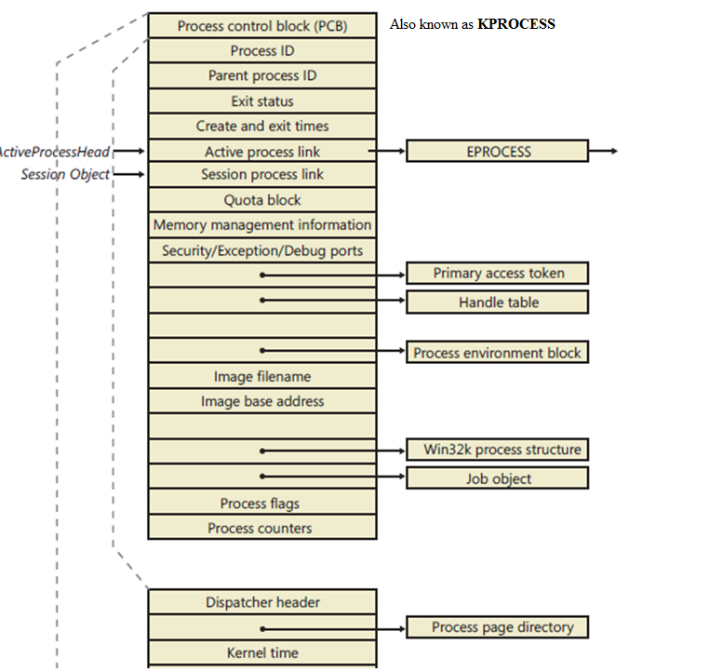
Windows Processes

Slide 33
Windows Process Creation
Steps of Windows CreateProcess (function):
Validate parameters; parse, validate, and convert the attribute list to its native counterpart.
Open the image file (.exe) to be executed inside the process.
Create the Windows executive process object. EPROCESS
Create the initial thread (stack, context, and Windows executive thread object).
Perform post-creation, Windows-subsystem-specific process initialization.
Start execution of the initial thread (unless the CREATE_ SUSPENDED flag was specified).
In the context of the new process and thread, complete the initialization of the address space (such as load required DLLs) and begin execution of the program

Slide 34
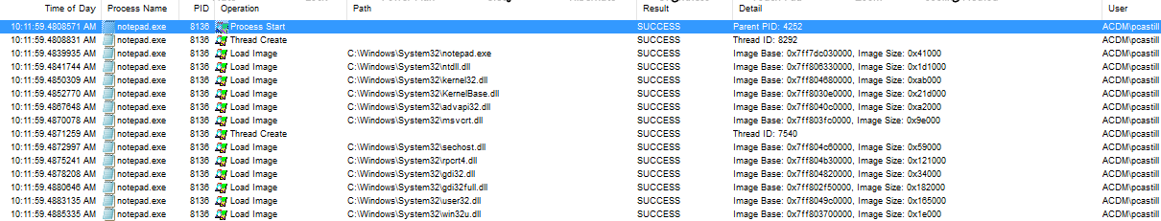
Windows System Internals Tools
Process Explorer and Process Monitor (Promon) tools can be used to analyze Windows processes behaviour
https://www.youtube.com/watch?v=Wuy_Pm3KaV8&list=PLI63-CUdihCrI3eAG2UN6hGR6CiS1yTMV&index=3

Slide 35
DLLs (Dynamic Linked Libraries)
A Dynamic Link Library (DLL) is a Windows module that contains functions (code) and data.
What is DLL? https://support.microsoft.com/en-us/kb/815065
DLLs help reduce memory overhead when several applications use the same functionality at the same time, because although each application receives its own copy of the DLL data, the applications share the DLL code.
In the body of the function, you may handle any combination of the following scenarios in which the DLL entry point has been called:
A process loads the DLL (DLL_PROCESS_ATTACH).
The current process creates a new thread (DLL_THREAD_ATTACH).
A thread exits normally (DLL_THREAD_DETACH).
A process unloads the DLL (DLL_PROCESS_DETACH).

Slide 36
DLLs (Dynamic Linked Libraries)
Many Windows functions allow programmers to import linked functions such as Loadlibrary and GetprocAddress that allow a program to access any function in any library on the system.
When a program calls linked library function, the function executes within the library. Functions called and libraries used are important part of a process because tell us what a program does and helps to identify which functions are being linked to by a suspect program.

Slide 37
Windows DLL
Windows DLL e.g.
Kernel32.dll It contains core functionality such as access and manipulation of memory, files and hardware
Advapi32.dll Allows access to Service Manager and Registry
User32.dll It contains user interface components such as buttons, scroll bars, etc
Gdi32.dll It contains functions to display and manage graphics

Slide 38
Windows DLL
Every DLL contains (imports) functions e.g kernel32.dll includes CreateThread, GetCurrentProcess, OpenProcess, GetProcessHeap and many more . It is important to get familiar with these functions to analyze and detect malicious software (malware analysis) . You can find details about DLL at Microsoft MSDN web site: https://msdn.microsoft.com/en-us/library/31d242h4%28v=vs.110%29.aspx

Slide 39
Processes’ system calls
Linux is a multiprogramming environment, and several processes are active in the system at any time
The fork and vfork system call creates (clones) a new process.
The exec program runs a new program
The wait system call allows a process to wait for a child to terminate
The exit system call terminates a process
The getpid system call will display the PID of the calling process
Use Linux man to verify header files required by each system call

Slide 40
fork() System Call
Processes are created by fork and vfork system call.
The fork system call must perform the following:
Reserve space for the child’s data and stack
Allocate a new PID and proc structure for the child
Initialize the child’s proc and hardware context
Allocate address Translation maps for the child
Make the child runnable and put it on scheduler queue
Arrange for the child to return from fork with a value of zero
Return the PID of the child to the parent

Slide 41

fork()
Create or Clones a process
#include <unistd.h>
int fork() (No arguments)
Output
-1 for error
0 child process
>0 Pid pid of child to parent process
fork() return value from Linux man:

Slide 42
exec() Family
Executes a program with path searching
#include <unistd.h>
execvp( const char *file, const char *argv[])
*file pointer to the file(program to execute)
*argv[] array of strings
Example
execvp( arglist[0], arglist )
execvp( “ls” , arglist )

Slide 43
wait() System call
Wait() system call performs the following operations:
Pauses the calling process until a child processes terminates its job
Retrieves the value the child process had passed to exit
Returns PID of the child that called exit

Slide 44
wait(&status)
Wait for process termination
#include <sys/types.h>
#include <sys/wait.h>
int wait( int &child_status)
int wait( NULL )
Return
-1 if error
PID of terminated process (child process)

Slide 45
exit() system call
Child process terminates its task and calls exit(n), where 0>=n<=255
Exit system call performs the following operations:
Close all file and directory descriptors
Change the parent PID of all children to the PID of init
Notify the parent if it is running wait or waitpid
Send the parent signal SIGCHLD

Slide 46
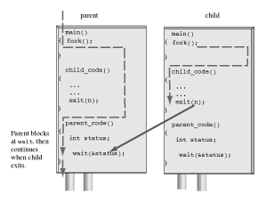
Wait () and Exit () system calls

Slide 47
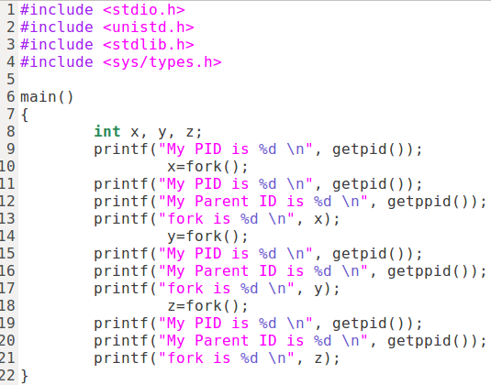
fork( ) behavior -Example

Slide 48
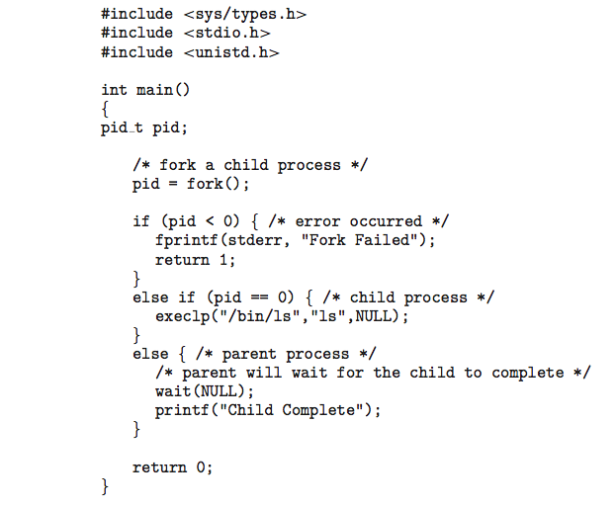
C Program Cloning Separate Process

Slide 49
Process Termination
What does the system have to do when a process is terminated?
All resources used by process must be returned to the OS
Clean-up is done by the parent process
Physical and virtual memory
Open files
Handles to I/O buffers

Slide 50
Process Termination
Conditions which terminate processes
Normal exit (voluntary)
Error exit (voluntary)
Fatal error (involuntary)
Killed by another process (involuntary)

Slide 51
Process Termination
Process executes last statement and asks the operating system to delete it (exit())
Output data from child to parent (via wait())
Process’ resources are deallocated by operating system
Parent may terminate execution of children processes (abort())
Child has exceeded allocated resources
Task assigned to child is no longer required
If parent is exiting
Some operating systems do not allow child to continue if its parent terminates
All children terminated - cascading termination
If no parent waiting, then terminated process is a zombie or orphan if process terminated is adopted by first process init or systemd

Slide 52
Signals Programming
A process can receive a signal or many signals at any time. The OS has handlers to handle signals. When a process receives a signal, the process will do one of the following:
Accepts the default action of the signal e.g. if we press Ctrl-C we send the signal SIGINT to a process. If the process accepts this signal, the process will be terminated
Ignores the signal. A process may ignore signals e.g. if you run the manual process, this process ignores SIGINT (Ctrl-c) to terminate the manual you have to use the SIGQUIT (ctr-\) or q
Changes the signal behavior. A process catches the signal and changes its behavior

Slide 53
SIGNALS Programming
The process that receives a signal can take one of the following actions:
Perform the default action (SIG_DFL)
Ignore the signal (SIG_IGN)
Catch the signal (function-name)
signal( SIGNAL-NAME, ACTION)
signal ( SIGINT, SIG_IGN)

Slide 54
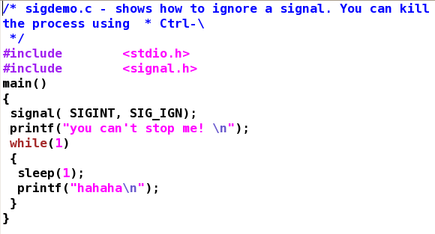
Signals –system calls

Slide 55
Inter-process Communication (IPC)
Processes within a system may be independent or cooperating. Processes communicate within the same system for many reasons:
Information sharing
Computation speedup
Modularity
Convenience
IPC techniques to communicate processes within the same system
Shared memory –faster than message passing
Message passing – good technique for small messages

Slide 56
Communications Models

Slide 57
Communications in Client-Server Systems
Sockets
Remote Procedure Calls (RPC)
Pipes
Remote Method Invocation (Java)

Slide 58
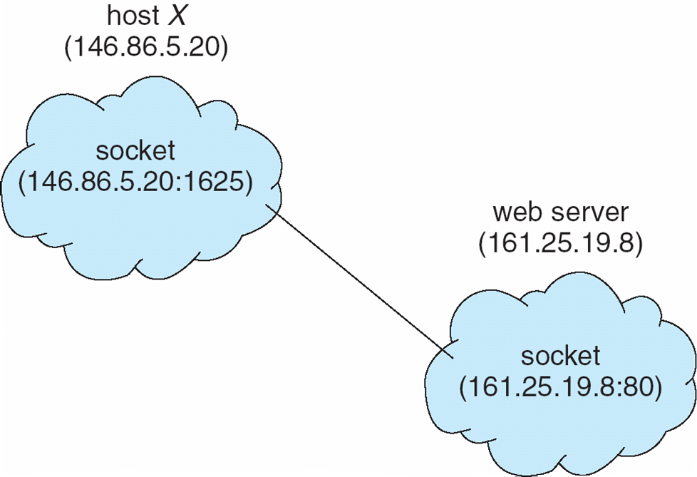
Sockets
A socket is defined as an endpoint for communication ( Linux: man socket)
Concatenation of IP address and port – a number included at start of message packet to differentiate network services on a host
The socket 161.25.19.8:1625 refers to port 1625 on host 161.25.19.8

Slide 59
Socket Types
There are two widely used socket types:
stream sockets: Stream sockets treat communications as a continuous stream of characters. Stream sockets use TCP , which is a reliable, stream oriented protocol
SOCK_STREAM
datagram sockets: datagram sockets have to read entire messages at once. Datagram sockets use UDP , which is unreliable and message oriented.
SOCK_DGRAM

Slide 60
Socket – Connection Oriented
socket()
bind()
Client
listen()
socket()
accept()
connection establishment
connect()
blocks until connection from client
data (request)
read()
write()
write()
data (reply)
read()

Slide 61
Socket- Connectionless
Server
Client
socket()
socket()
bind()
recvfrom()
data (request)
sendto()
blocks until data received from client
recvfrom()
sendto()
data (reply)

Slide 62
Socket () system call
Creates a socket
#include <sys/types.h>
#include <sys/socket.h>
Socket(int domain, int type, int protocol)
Use Linux manual to verify system calls arguments and headers required

Slide 63
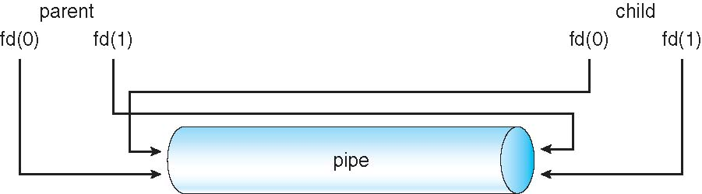
Pipes
Acts as a conduit allowing two processes to communicate
Ordinary Pipes allow communication in standard producer-consumer style
Producer writes to one end (the write-end of the pipe)
consumer reads from the other end (the read-end of the pipe)
Ordinary pipes are therefore unidirectional
Require parent-child relationship between communicating processes

Slide 64
References
Operating System Concepts. Silberschatz, Galvin, Gagne. Latest Edition. John Wiley & Sons.

Slide 65
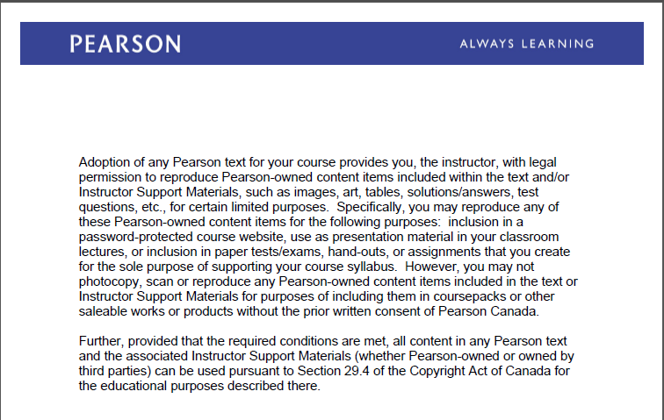
Text Book Slides – Copy Right

